Slide 1
SHaRED – Data Submission Tool
Workshop at
Ecological Society of Australia 2021
Habacuc Flores & Elisa Girola
h.floresmoreno@uq.edu.au, e.girola@uq.edu.au

Slide 2
Outline of the workshop
Introduction to TERN
FAIR data principles
Introduction to SHaRED
Demonstration of SHaRED (FAIR data principles at work)
Q&A

Slide 3
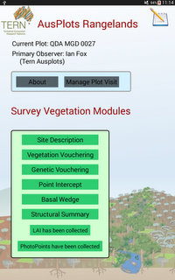
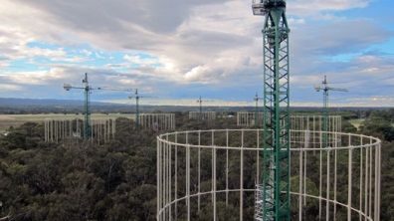
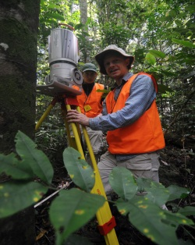
TERN Purpose¹
National collaborative research infrastructure for collecting, collating, storing and sharing Australia’s terrestrial ecosystem data sets and knowledge.
¹ TERN is supported by the Australian Government through the National Collaborative Research Infrastructure Strategy from 2009.

Slide 4
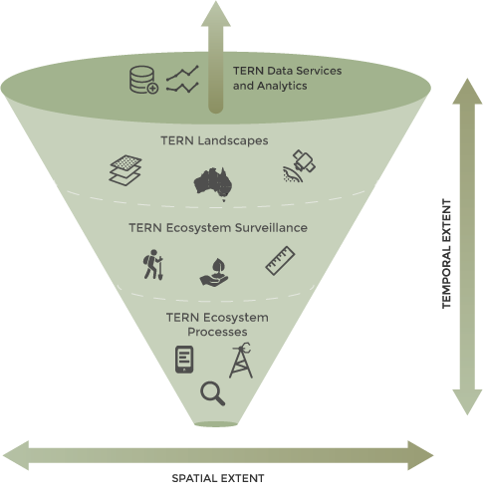
TERN in Operation
Satellite remote sensing products
Land cover dynamics and phenology
Vegetation composition and structure
Fire dynamics and impacts
Continental Soil & Landscape data
Plot-based surveillance monitoring
Soil sample, leaf tissue samples, LAI, Basal area
Photopoints
Carbon, energy, water fluxes
Phenocams, LAI,
Acoustic sensors
Flora population

Slide 5
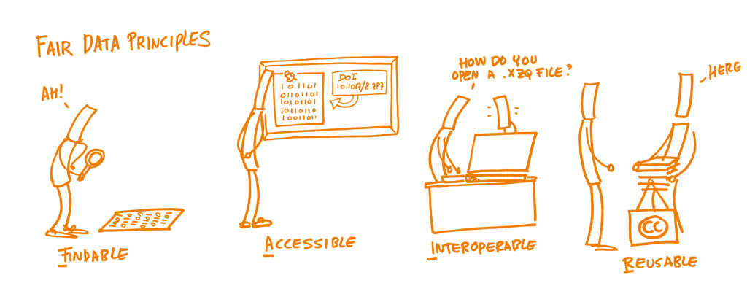
FAIR principles

Slide 6
FAIR principles
FINDABLE
F1. (meta)data are assigned a globally unique and persistent identifier
F2. data are described with rich metadata (defined by R1 below)
F3. metadata clearly and explicitly include the identifier of the data it describes
F4. (meta)data are registered or indexed in a searchable resource

Slide 7
FAIR principles
ACCESIBLE
A1. (meta)data are retrievable by their identifier using a standardized communications protocol
A1.1 the protocol is open, free, and universally implementable
A1.2 the protocol allows for an authentication and authorization procedure, where necessary
A2. metadata are accessible, even when the data are no longer available

Slide 8
FAIR principles
INTEROPERABLE
I1. (meta)data use a formal, accessible, shared, and broadly applicable language for knowledge representation.
I2. (meta)data use vocabularies that follow FAIR principles
I3. (meta)data include qualified references to other (meta)data

Slide 9
FAIR principles
REUSABLE
R1. meta(data) are richly described with a plurality of accurate and relevant attributes
R1.1. (meta)data are released with a clear and accessible data usage license
R1.2. (meta)data are associated with detailed provenance
R1.3. (meta)data meet domain-relevant community standards

Slide 10
Why FAIR matters?
Framework for Data management
Improve human and machine actionable data representation
Help data management, data sharing and reuse
Strong importance for both metadata and data
Make data more valuable for reuse

Slide 11
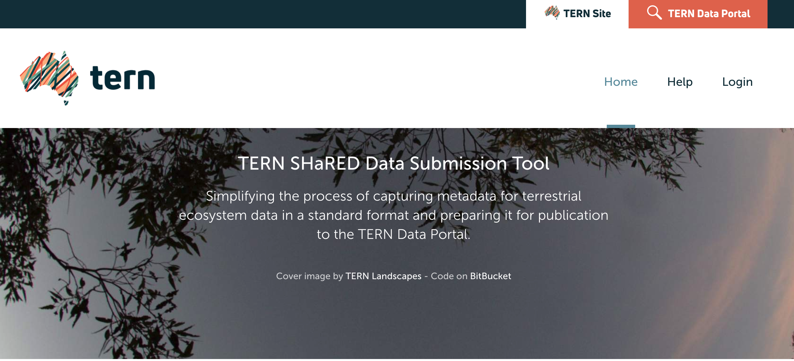
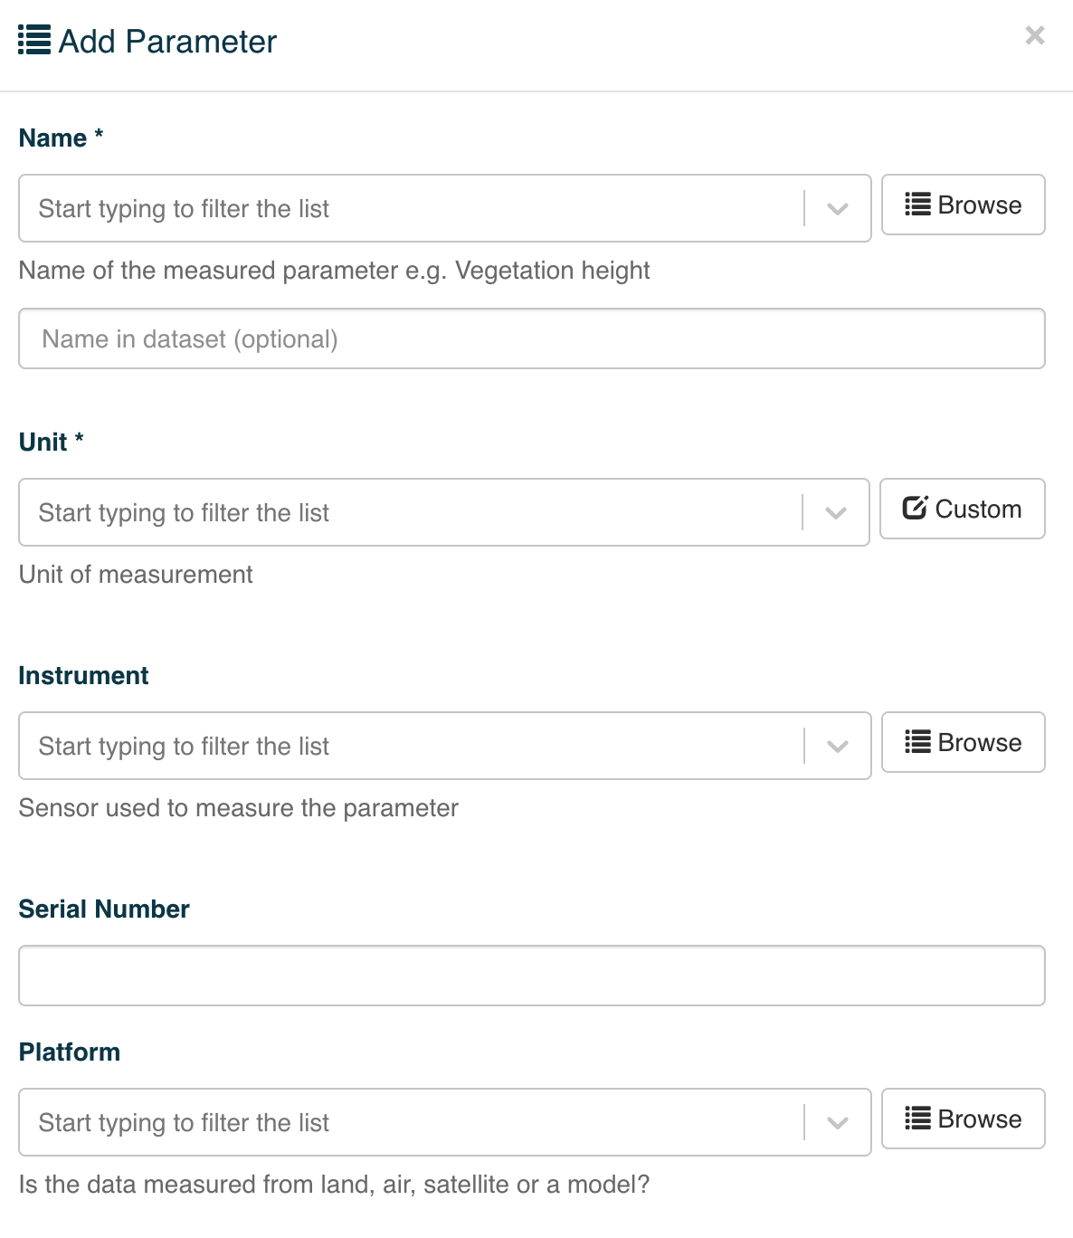
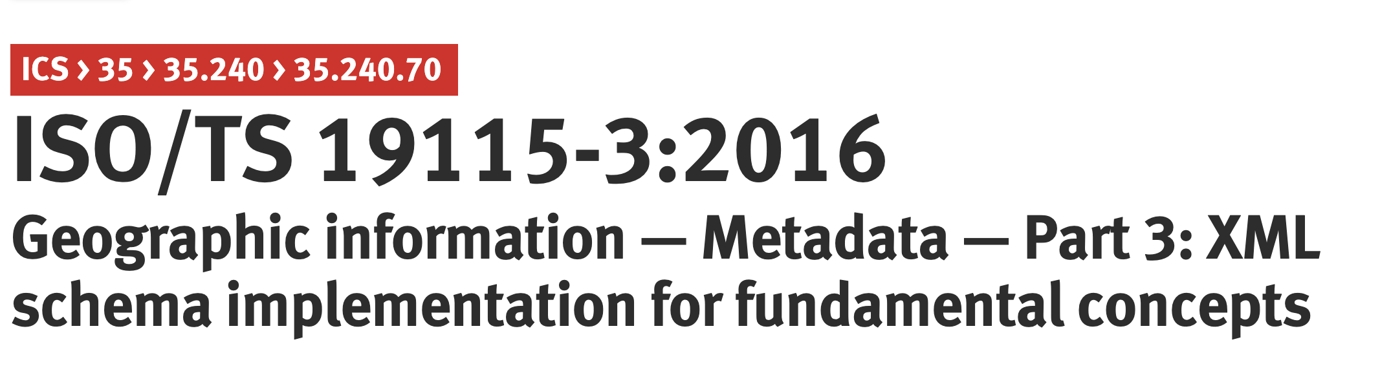
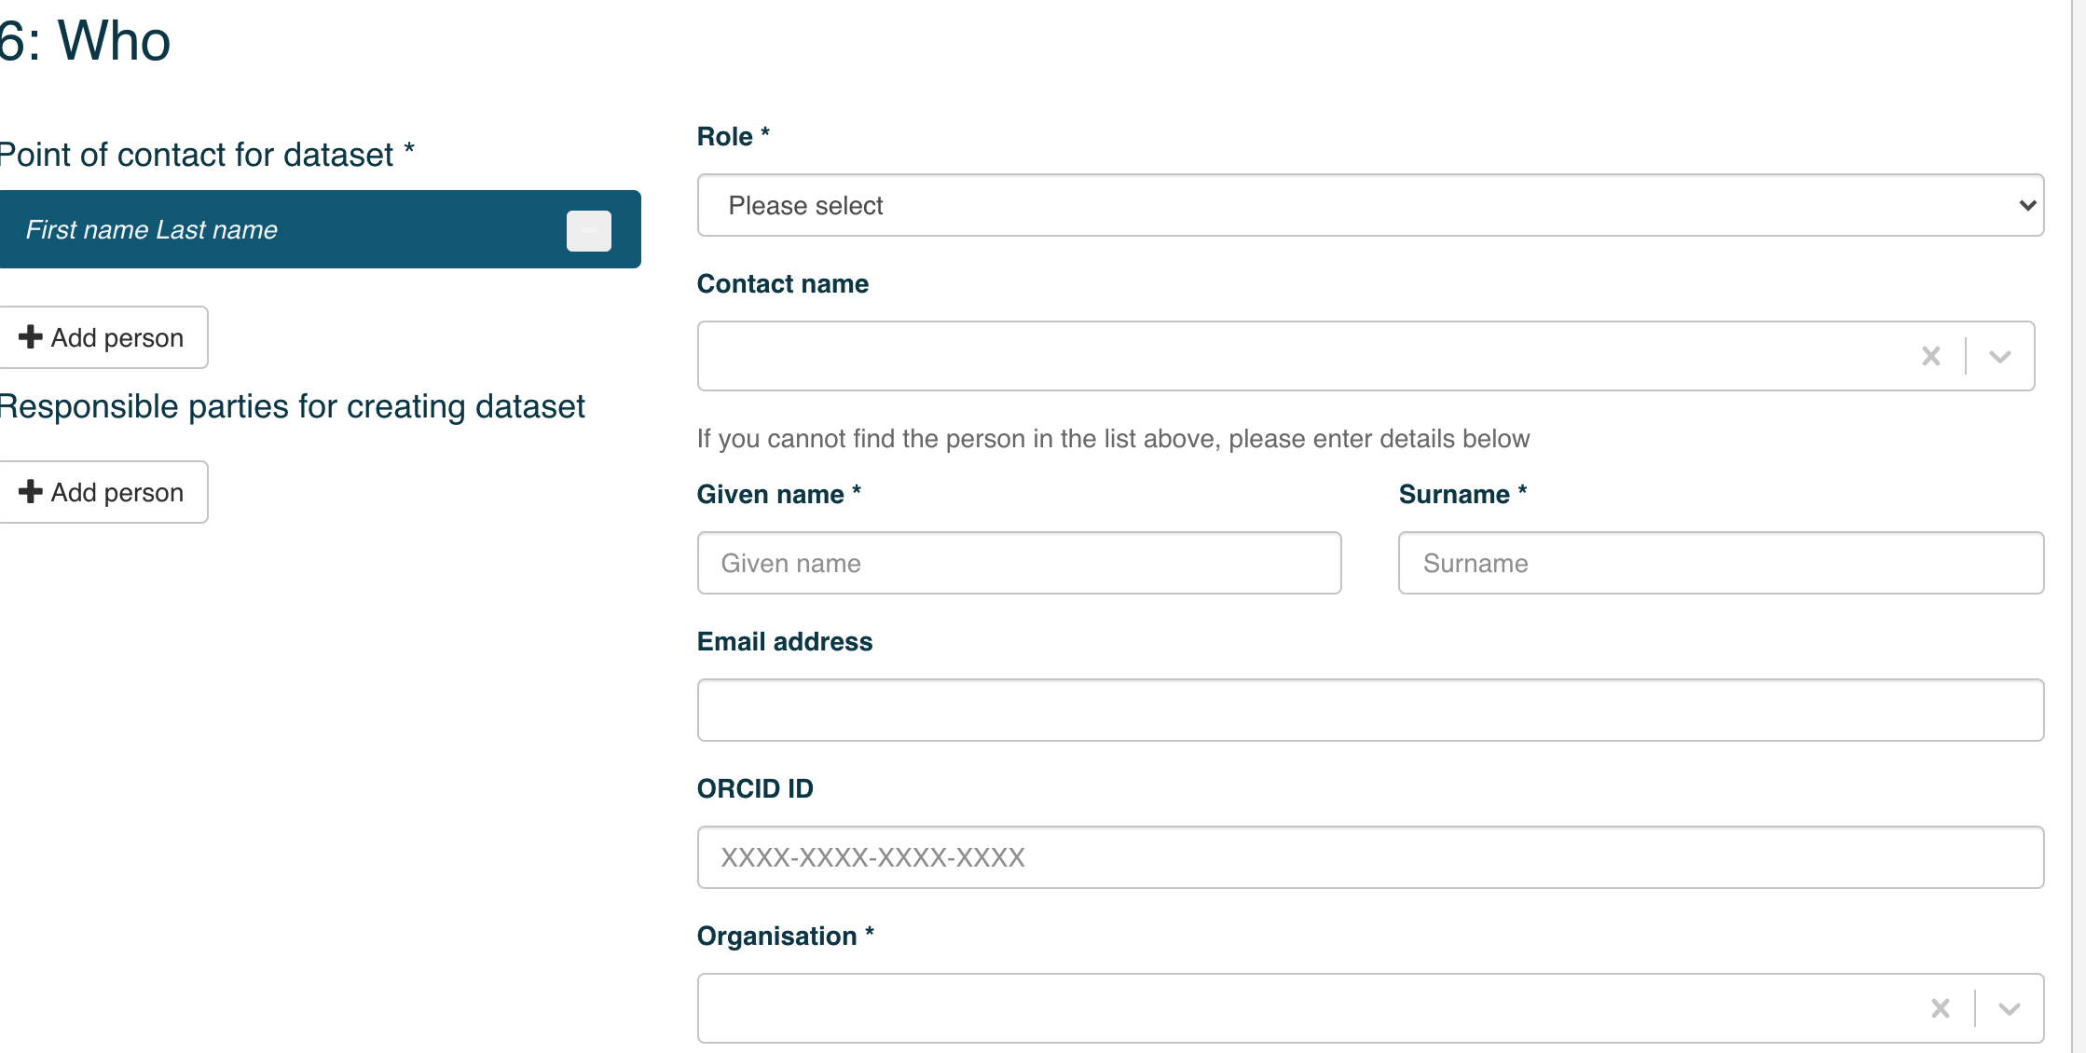
SHaRED Features
Support AAF and Google Account
Support ISO 19115-3 metadata standard
widely used with strong community support
Metadata entry are part of set of questionnaire
Use controlled vocabularies
Select geographical region
Describe associated people
Upload files
Upload files
Link URL of data services
All data submitted is published under CC-BY 4.0
Request DOI
Submit

Slide 12
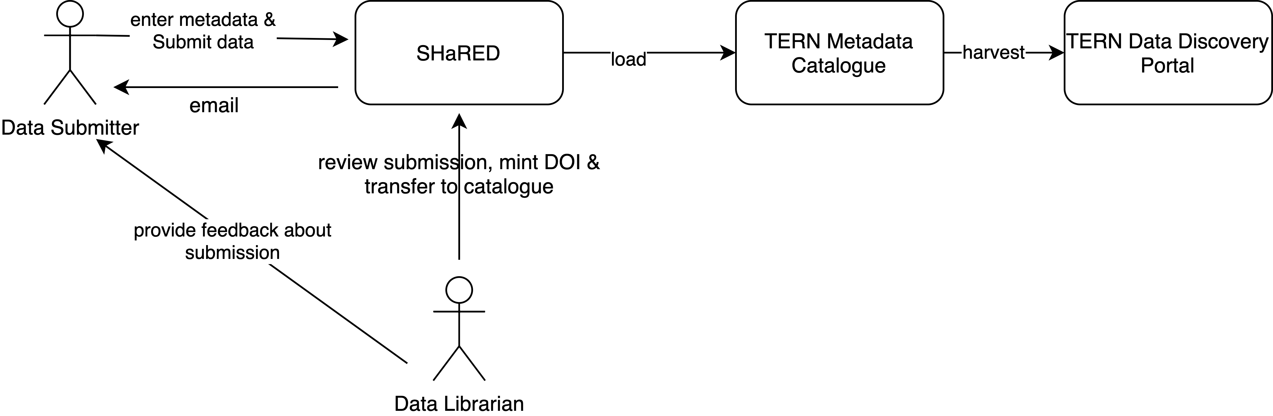
SHaRED - Data Submission tool

Slide 13
SHaRED live example

Slide 14
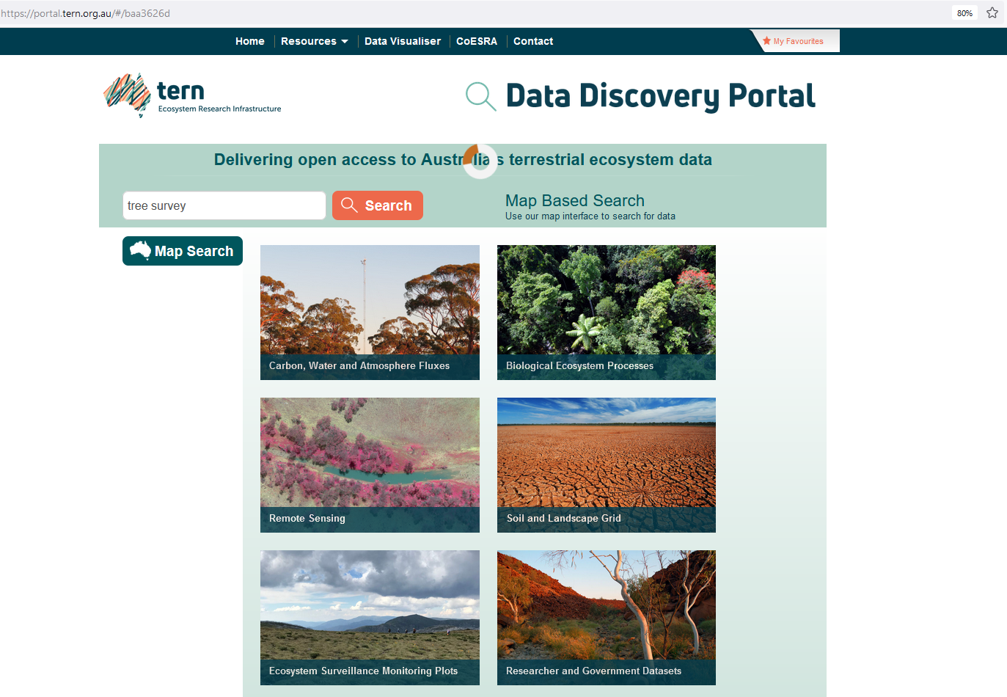
TERN Data Discovery Portal
https://portal.tern.org.au
Search keywords
Notes:
F4. (meta)data are registered or indexed in a searchable resource.

Slide 15
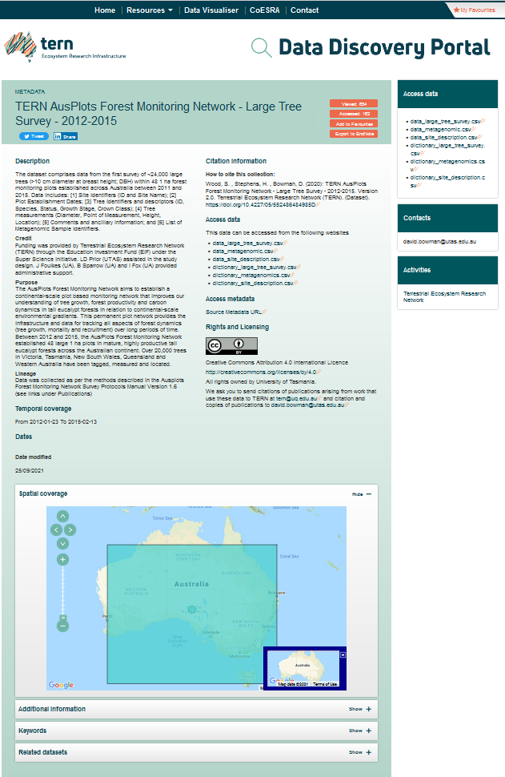
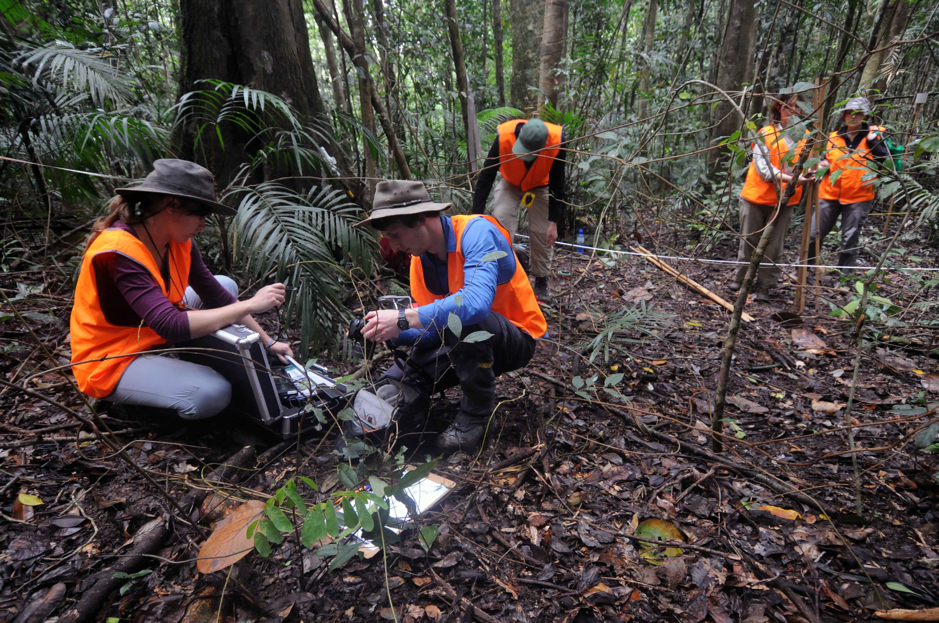
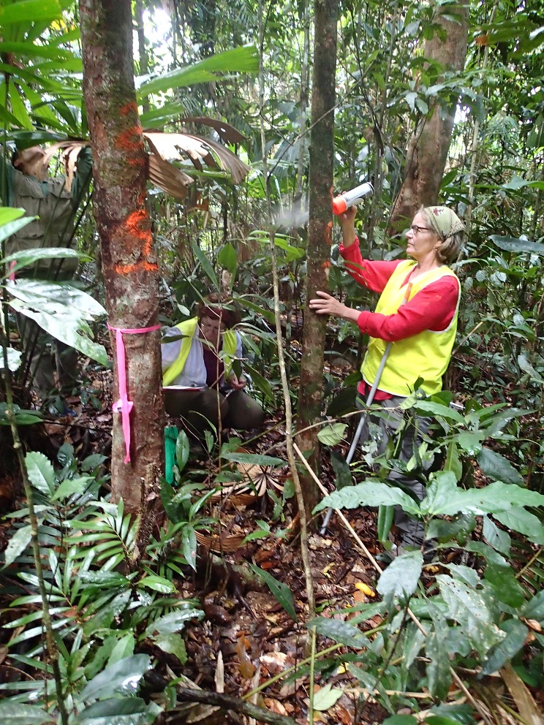
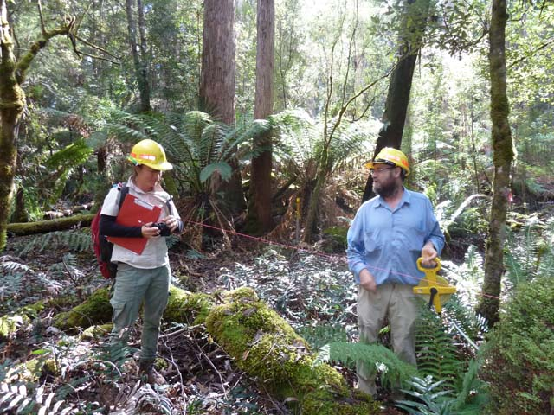
Metadata on TERN Data Discovery Portal
Notes:
F2. data are described with rich metadata.
R1.3. (meta)data meet domain-relevant community standards. Compatible with ecological data standards. And RIFcf

Slide 16
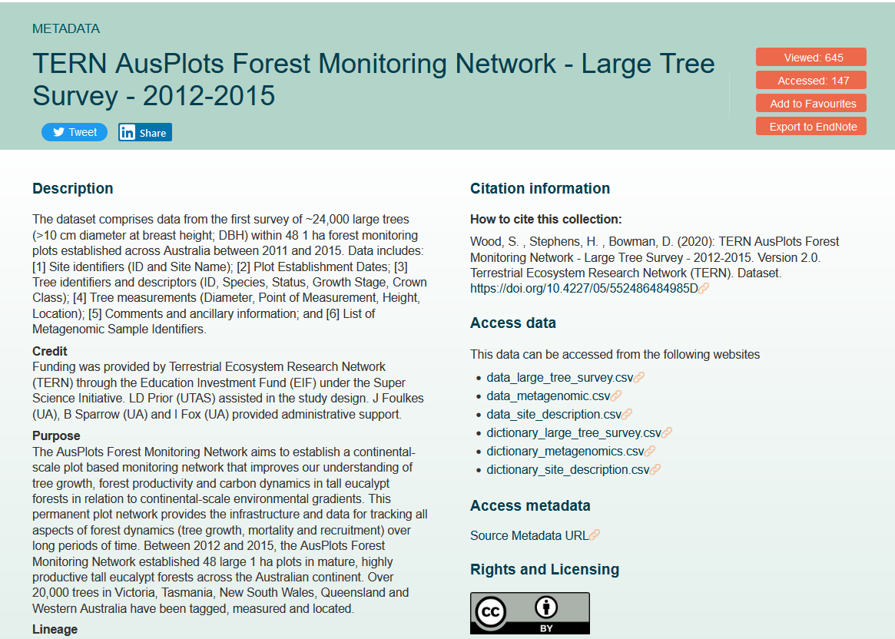
Metadata on TERN Data Discovery Portal
Title
Abstract
Credit
Purpose

Slide 17
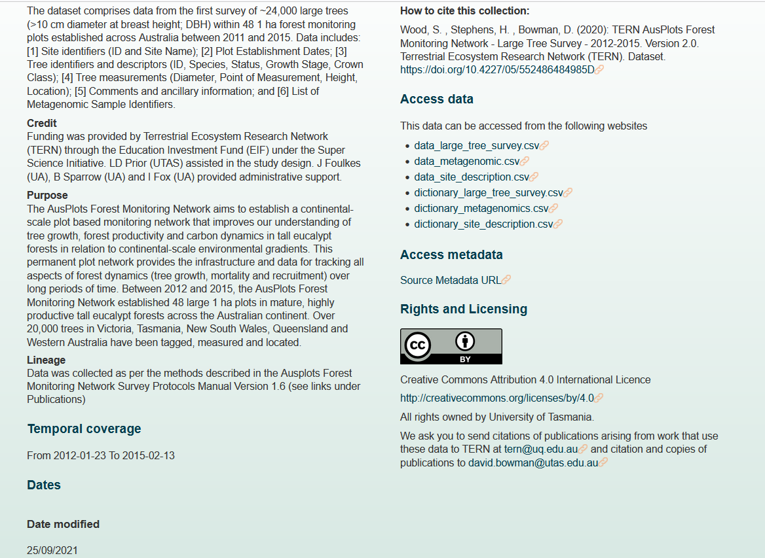
Metadata on TERN Data Discovery Portal
Abstract
How to cite these data
Links to data
Credit
Purpose
Lineage
Temporal cover

Slide 18
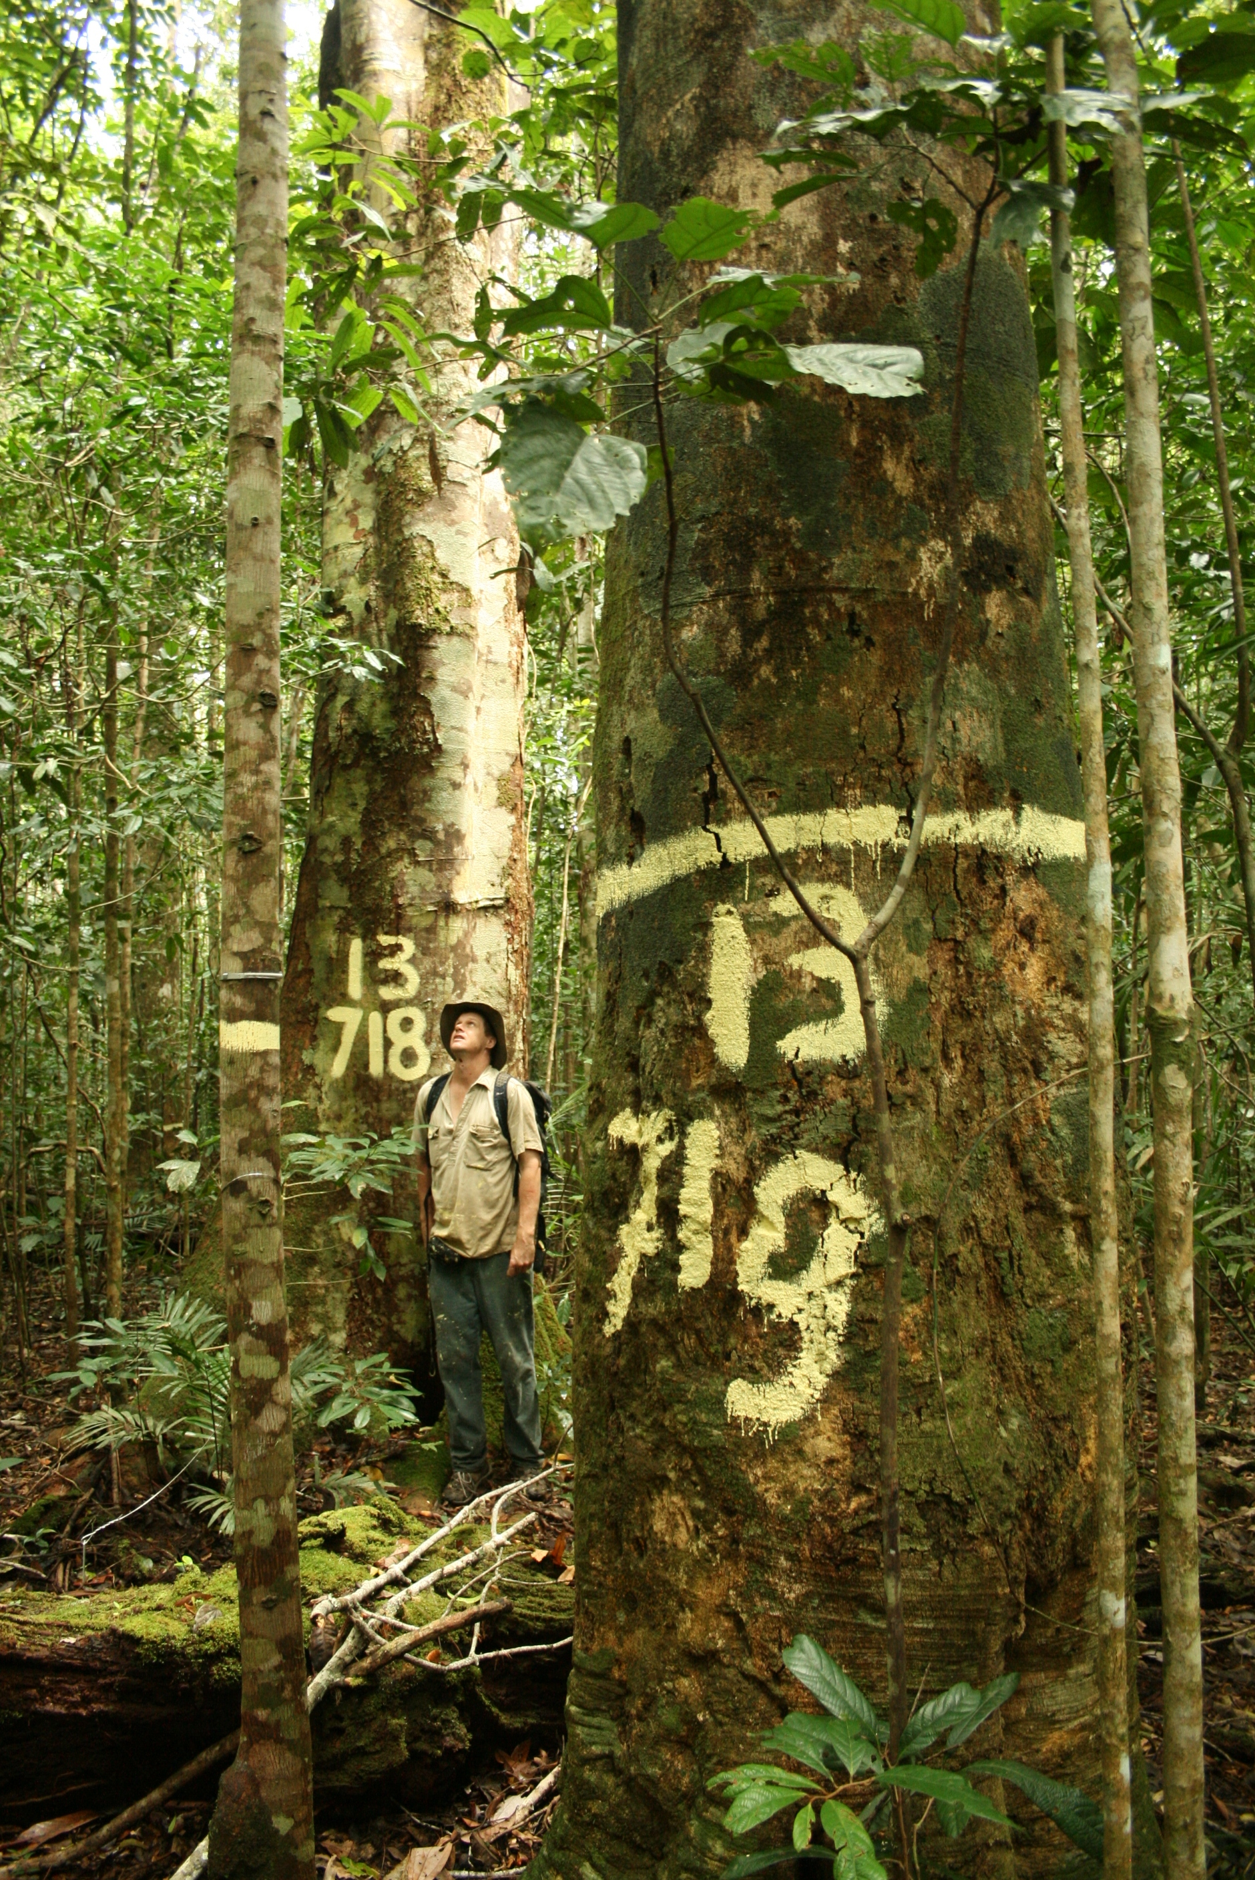
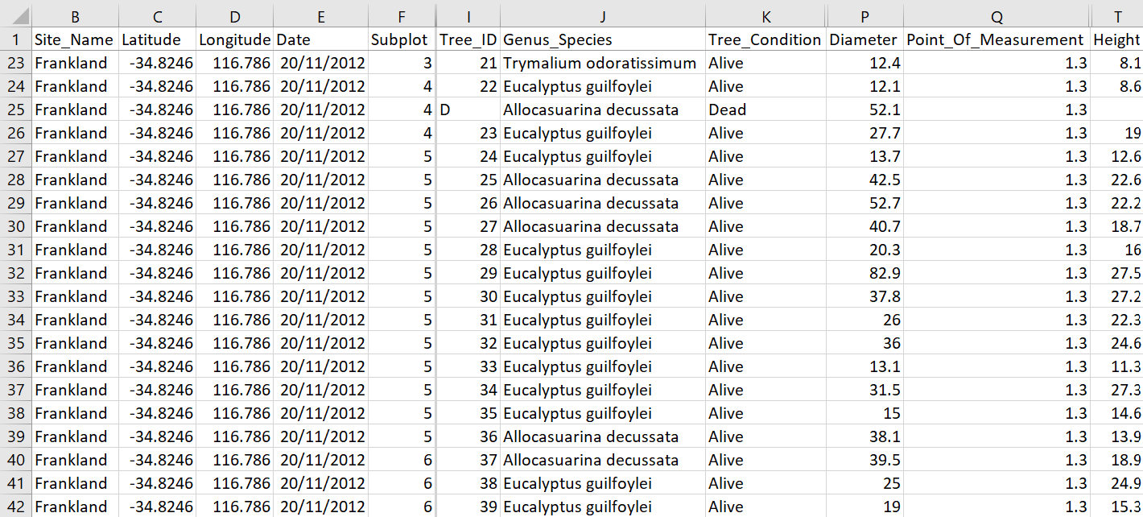
Example of data – tree measurements

Slide 19
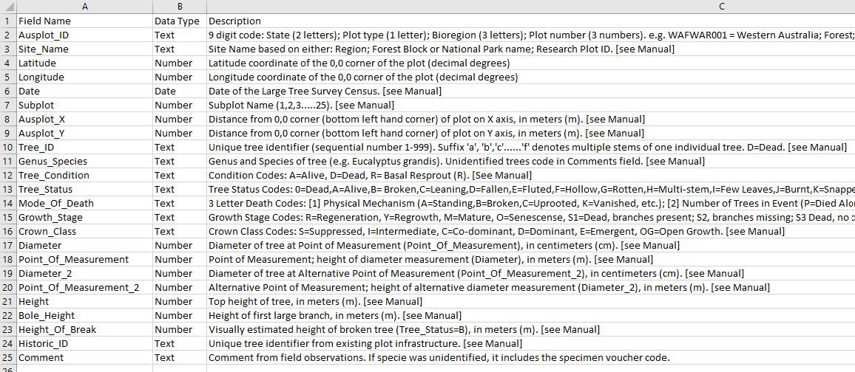
Example of data – dictionary

Slide 20
Metadata on TERN Data Discovery Portal
Abstract
How to cite these data
Links to data
Credit
Purpose
Persistent URL in geonetwork
Lineage
Temporal cover
Temporal cover
Notes:
R1.1. (meta)data are released with a clear and accessible data usage license.
R1.2. (meta)data are associated with their provenance. (where the data comes from) = data lineage.

Slide 21
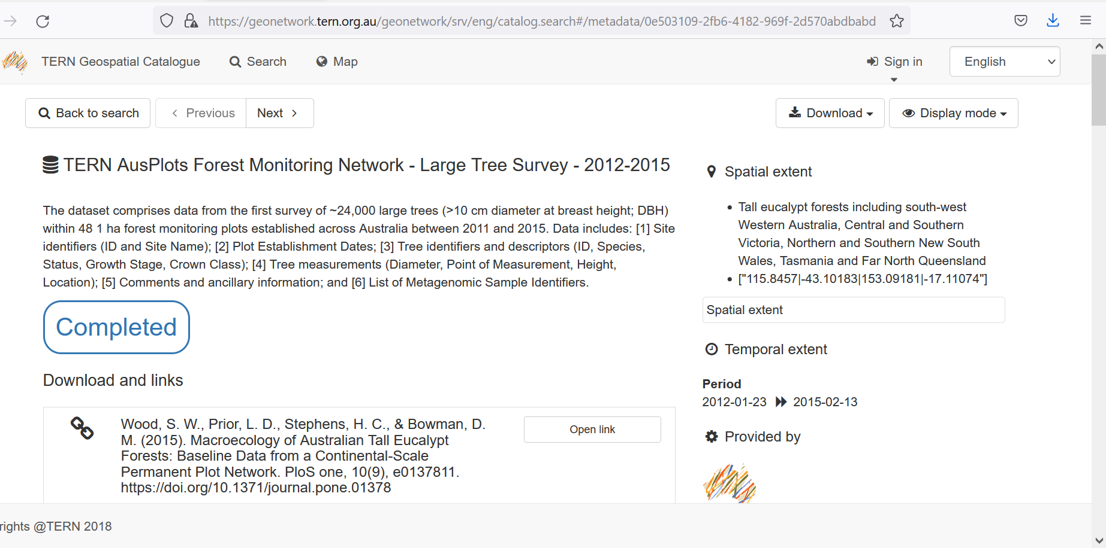
Metadata on Geonetwork
Persistent URL in geonetwork
Notes:
F1. (meta)data are assigned a globally unique and eternally persistent identifier.
A1. (meta)data are retrievable by their identifier using a standardized communications protocol. The metadata is retrievable using a standard http protocol.
A1.1. the protocol is open, free, and universally implementable.
A1.2. the protocol allows for an authentication and authorization procedure, where necessary.

Slide 22
Metadata on TERN Data Discovery Portal
Abstract
How to cite these data
Links to data
Credit
Purpose
Persistent URL in geonetwork
Rights and licencing
Temporal cover

Slide 23
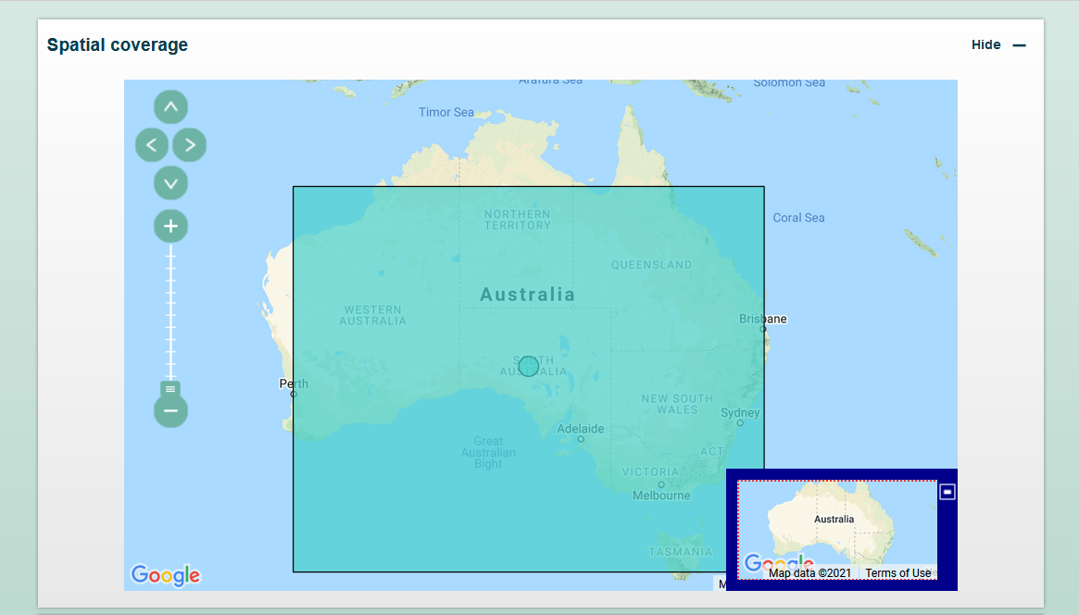
Metadata on TERN Data Discovery Portal

Slide 24
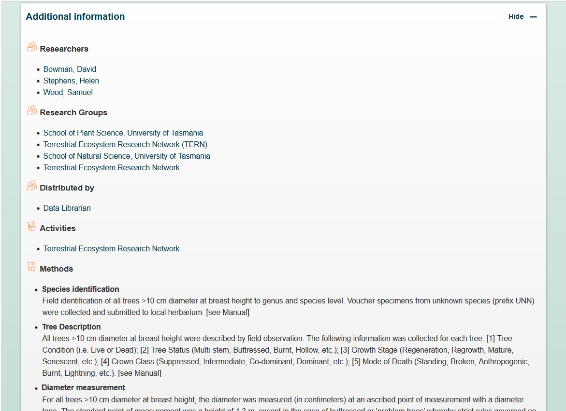
Metadata on TERN Data Discovery Portal
Researchers
Organizations
Methods

Slide 25
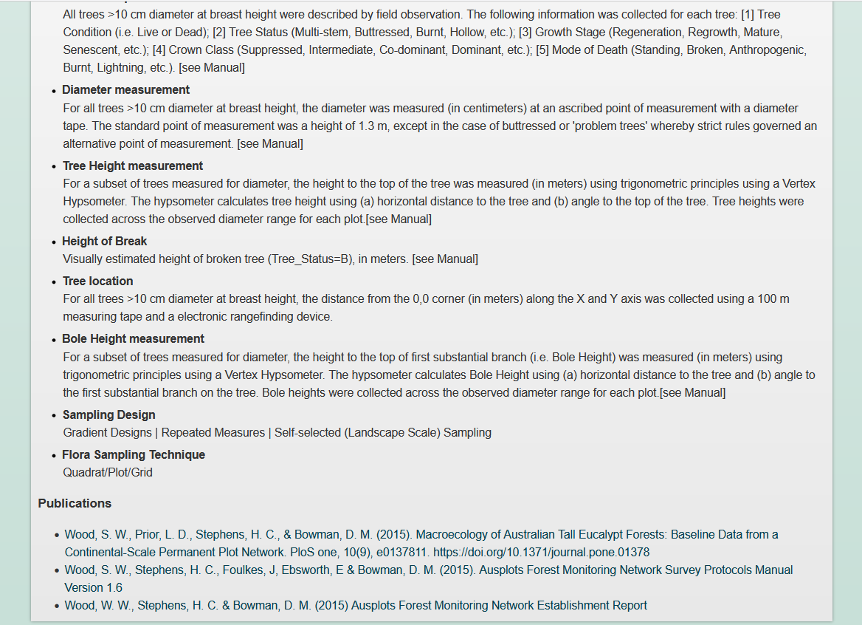
Metadata on TERN Data Discovery Portal
Methods
Publications
Notes:
I3. (meta)data include qualified references to other (meta)data.

Slide 26
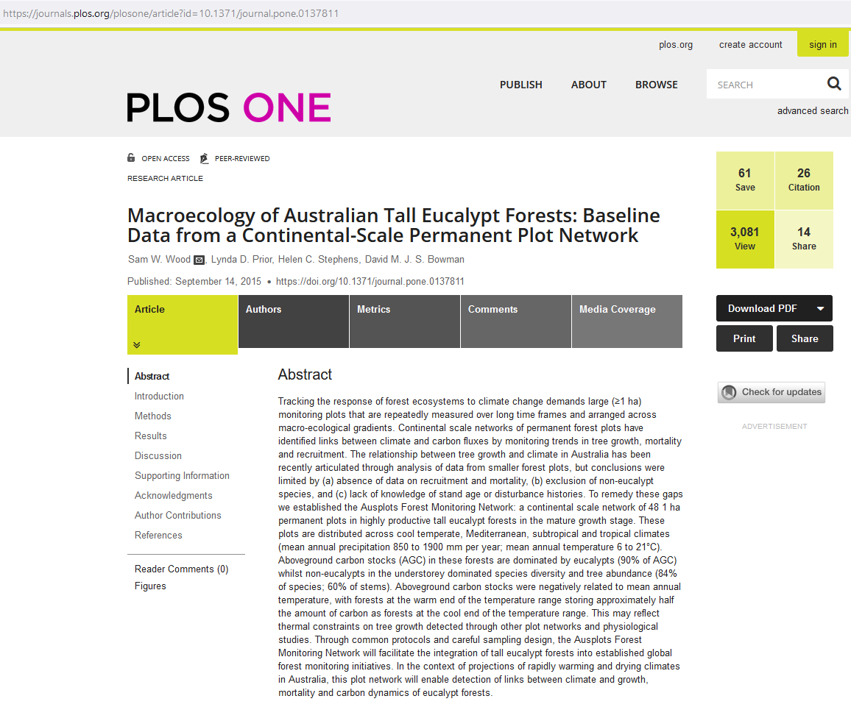
Linked publication

Slide 27
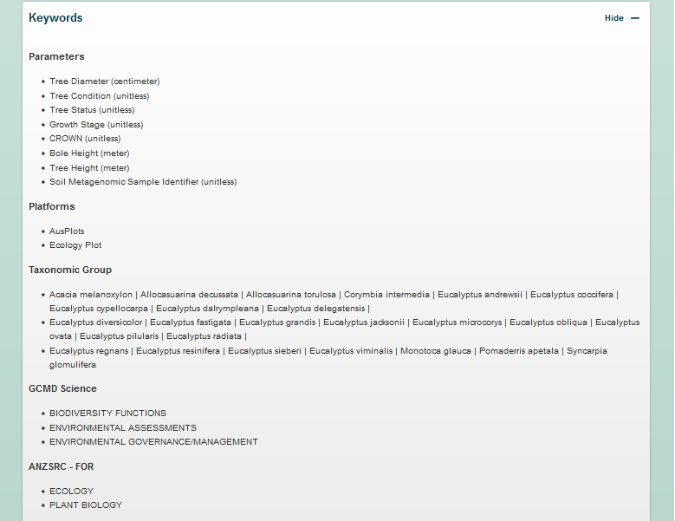
Metadata on TERN Data Discovery Portal
Parameters
Platforms
Taxonomic Group
GCMD Science
ANZSRC - FOR
Notes:
GCMD = Global Change Master Directory
ANZSRC = Australian and New Zealand Standard Research Classification Field of Research
I1. (meta)data use a formal, accessible, shared, and broadly applicable language for knowledge representation.
I2. (meta)data use vocabularies that follow FAIR principles.
R1. meta(data) have a plurality of accurate and relevant attributes.

Slide 28
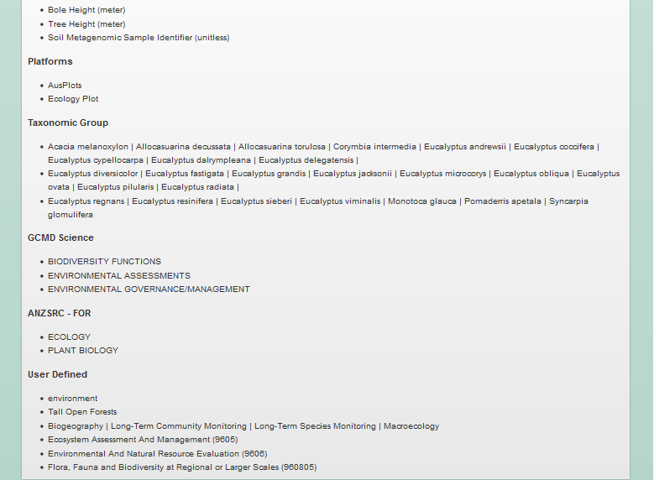
Metadata on TERN Data Discovery Portal
Platforms
Taxonomic Group
GCMD Science
ANZSRC - FOR
User Defined
Notes:
GCMD = Global Change Master Directory
ANZSRC For = Australian and New Zealand Standard Research Classification Field of Research
SEO = Socio-economic Objective, part of ANZSRC

Slide 29
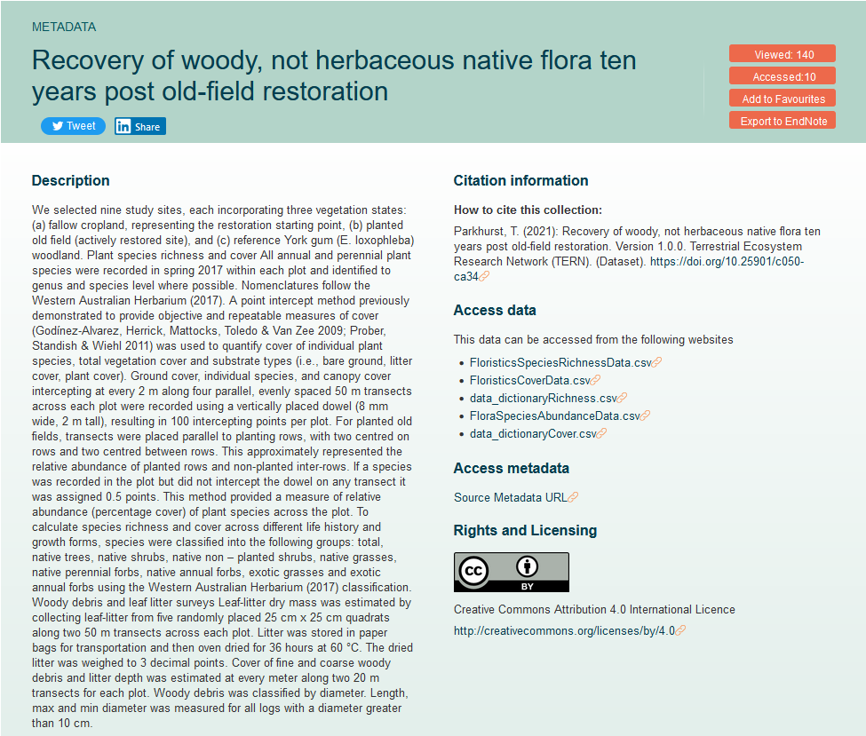
Metadata on TERN Data Discovery Portal
Abstract
Links to data

Slide 30
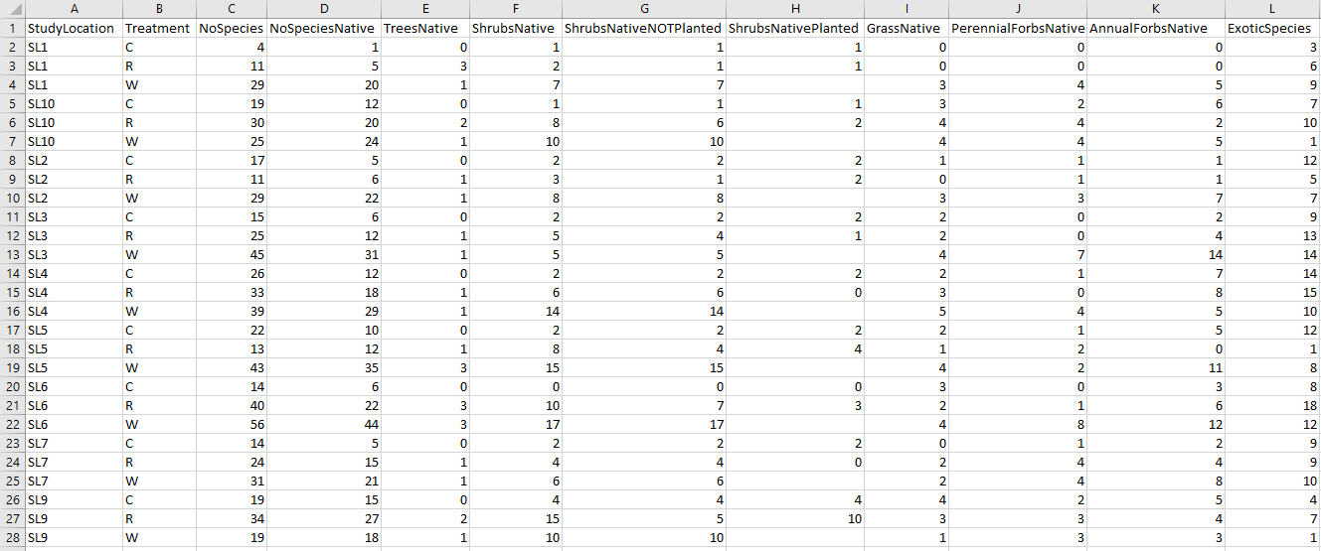
Example of data – species richness

Slide 31

We at TERN acknowledge the traditional owners and their custodianship of the lands on which TERN operates. We pay our respects to their ancestors and their descendants, who continue cultural and spiritual connections to country.
TERN is enabled by NCRIS.
Our work is a result of collaborative partnerships with many universities and institutions.
To find out more please go to tern.org.au.
Acknowledge the use of ARDC infrastructure

Slide 32
TERN Services and useful resources
TERN Resources:
Data Submission – https://shared.tern.org.au
Metadata Catalogue - https://geonetwork.tern.org.au/
Data Discovery – https://portal.tern.org.au
EcoImages portal – https://ecoimages.tern.org.au/
TERN Knowledge Base – https://ternaus.atlassian.net/wiki/spaces/TERNSup/overview
FAIR Principles - https://ardc.edu.au/resources/working-with-data/fair-data/
COMING SOON
EcoPlots portal – https://ecoplots.tern.org.au/

